Slide 1
ROAD DETECTION USING FCN
Harish N Sathishchandra
John Greenawalt
Zhong Tu
Hui Hao

Slide 2
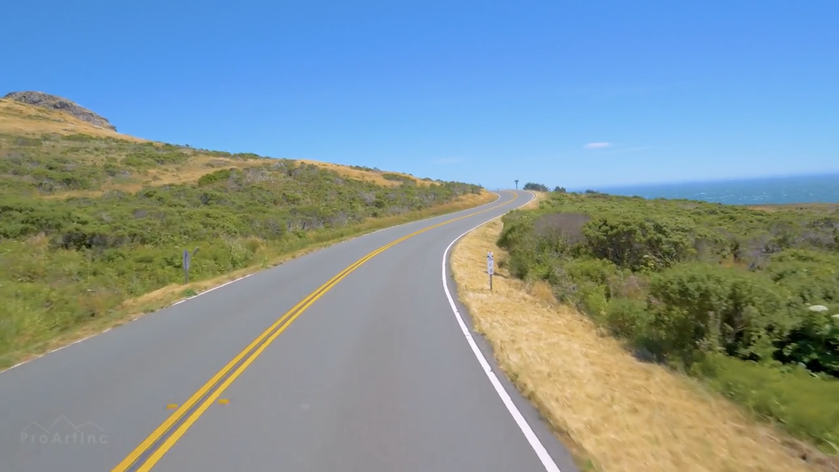
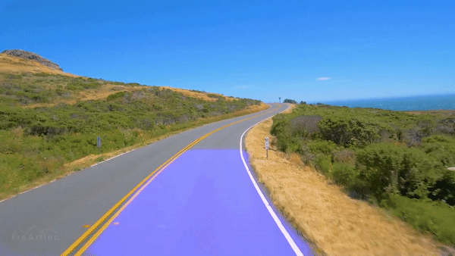
Project Goal
Our task was to develop a model that detects a variety of road types.
Highways and urban roads are clearly marked by lines and other isolation strips, making detection easy.
Rural roads are far more challenging, with more variability and often vague markings. For our project, we focused on rural roads.

Slide 3
Motivation
Autonomous vehicles are a fast-growing area of research.
Lane detection can help inattentive drivers when they drift.
This feature is an important step on the way to full autonomy.

Slide 4
Datasets
Very few open curated datasets available.
Type of labeling did not match our CNN model, e.g., Point cloud based and GPS labeling.
Took two rural road datasets from KITTI for training and validation.
Took videos from YouTube for testing.
https://www.youtube.com/watch?v=JHAcW9cU0mY&t=11024s

Slide 5
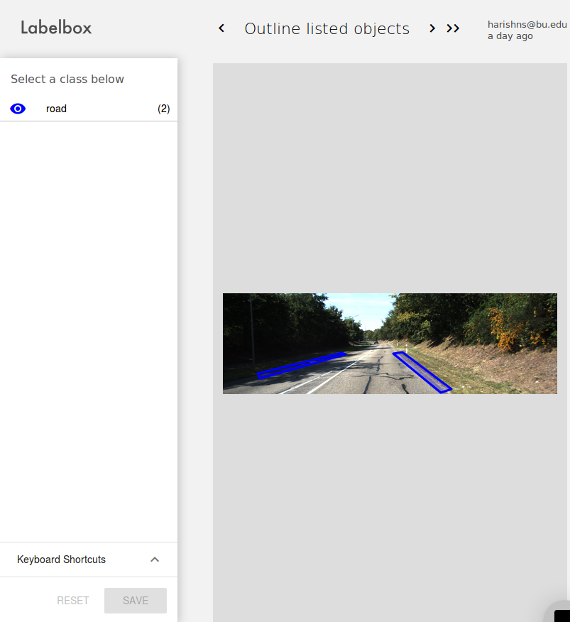
Labeling method
Marked four sets of coordinates for each edge of the road producing a rectangle around the edges.
Pixels within this rectangle labeled as edges.

Slide 6
Summary of our Model
First we tried to use a CNN model to solve the problem. Most CNNs end fully connected layers and output of these layers is like a vector of features.
For the road detection problem, we want to map the output vector directly onto the input image.
So instead of using fully connected layer, we decided to use deconvolution layers and built a FCN model.

Slide 7
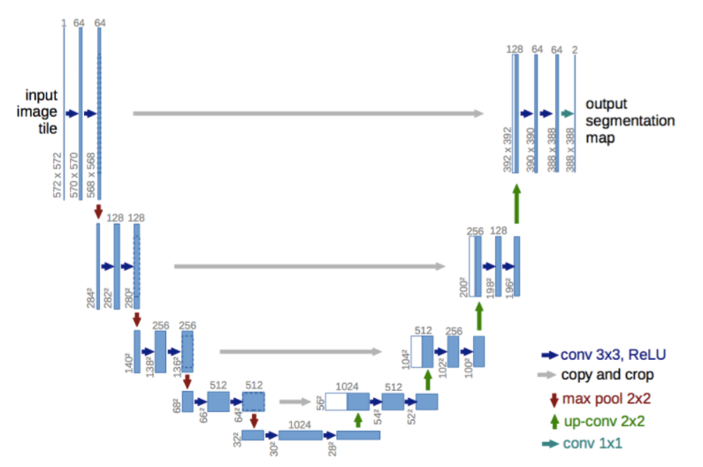

Slide 8
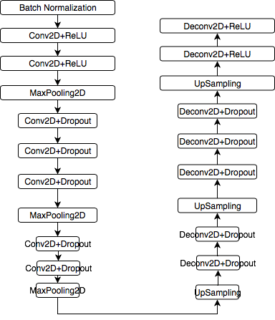

Slide 9
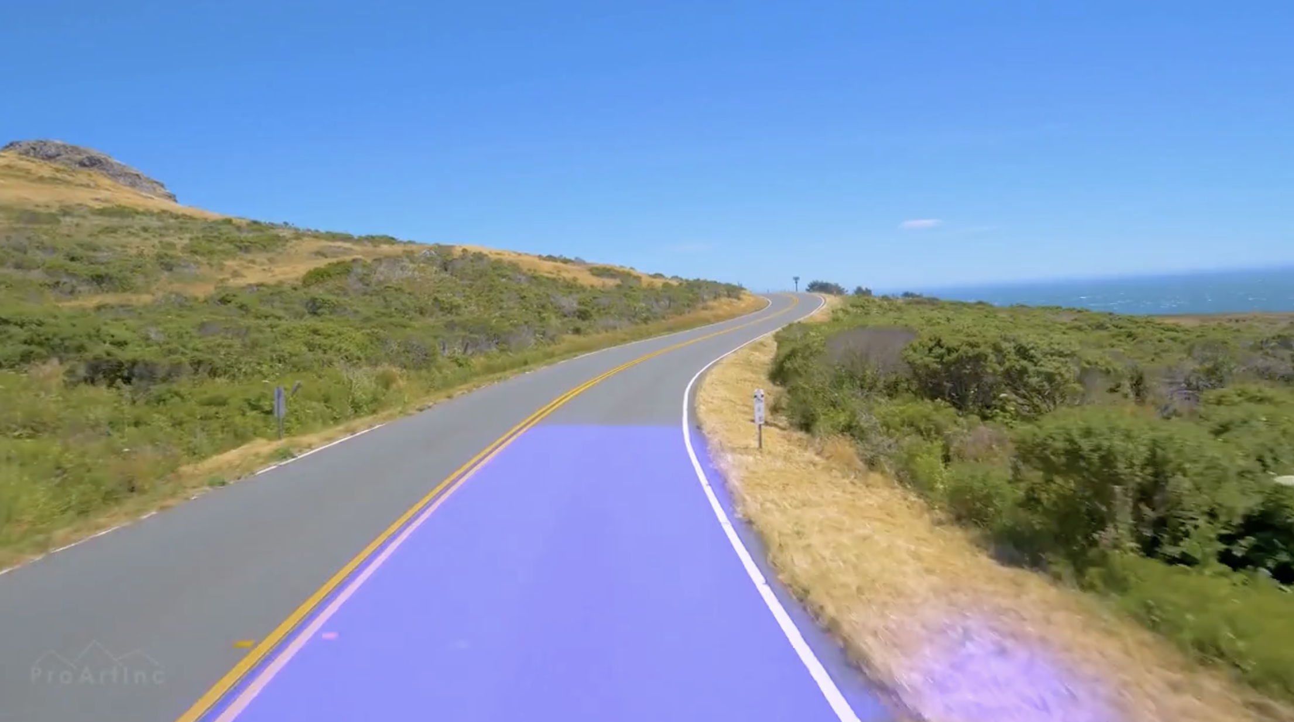
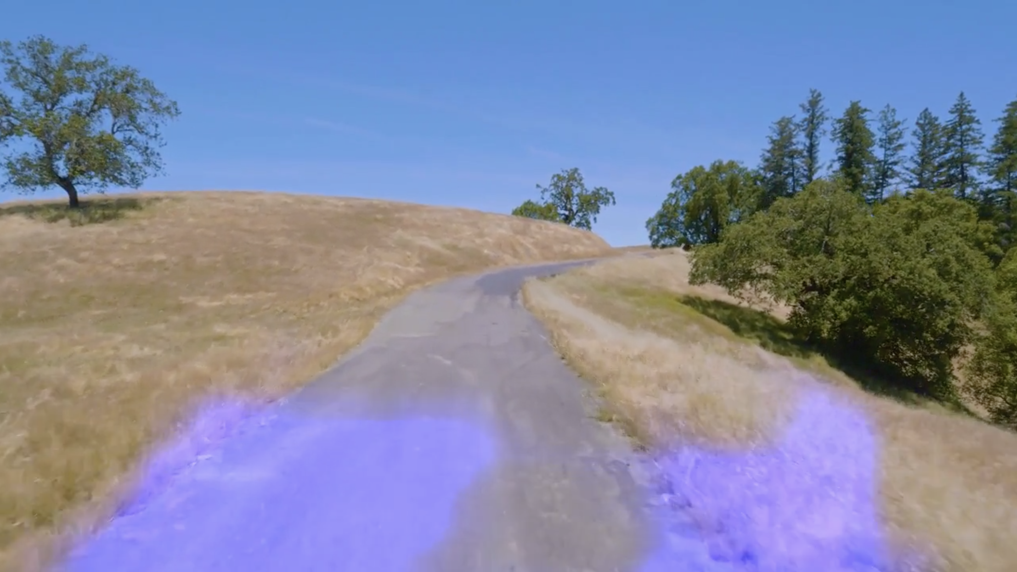
Model Refinement
Our original FCN model had decent performance and acted as a baseline.
Trying to improve results, we first tried adjusting the padding method and increasing the number of training epochs. The results are shown below.

Slide 10
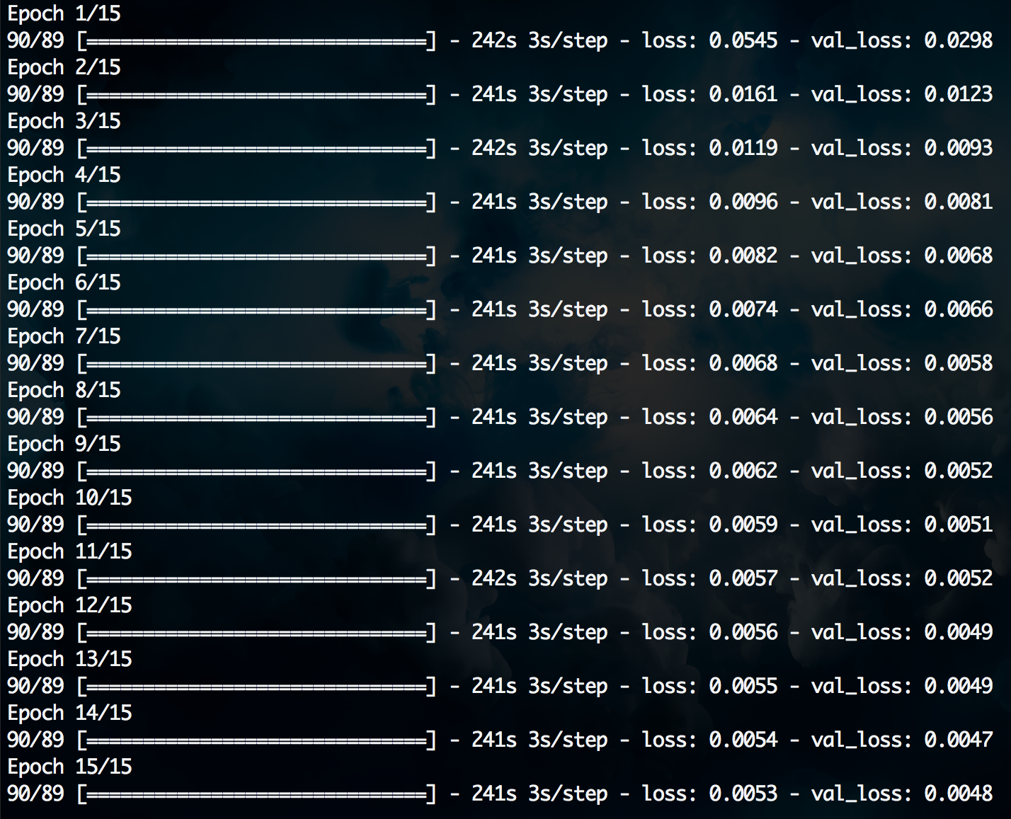
Training with 15 epochs marginally improved losses, but resulted in overfitting

Slide 11
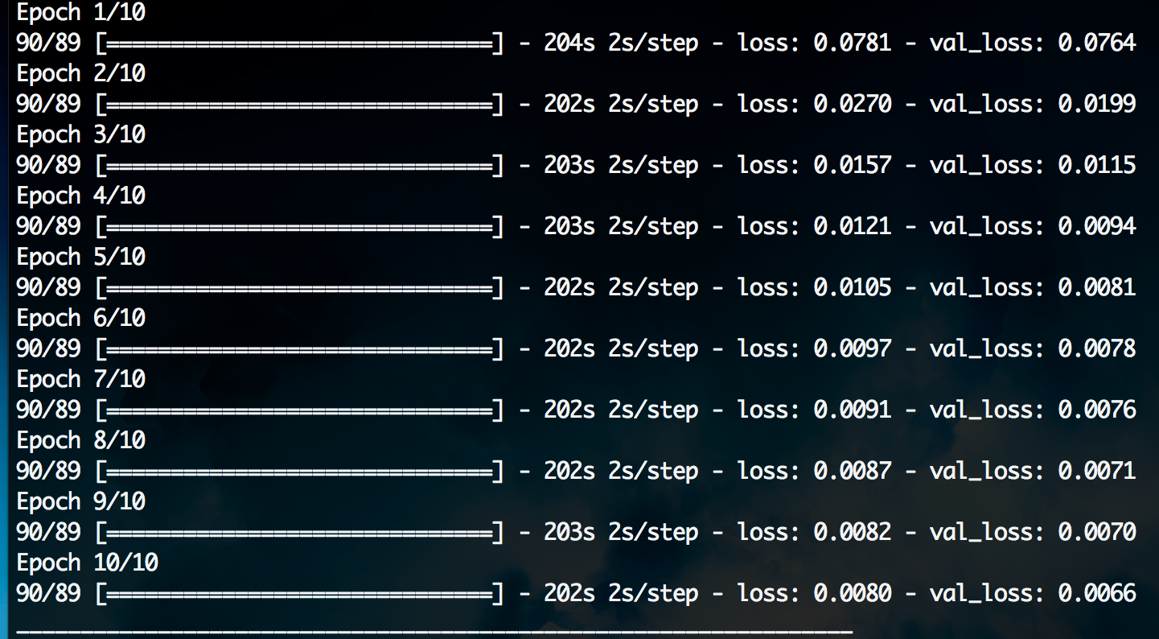
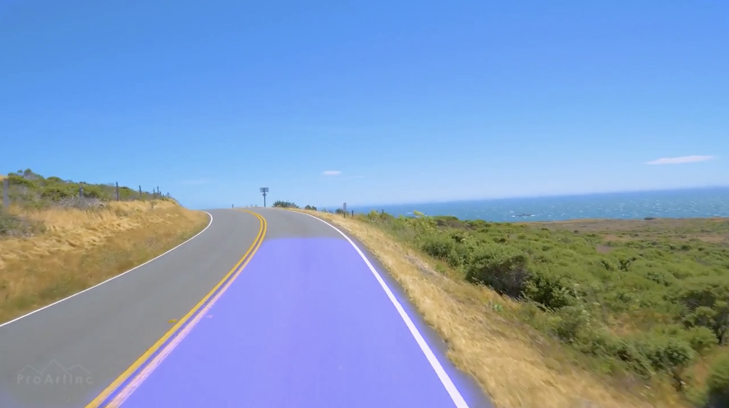
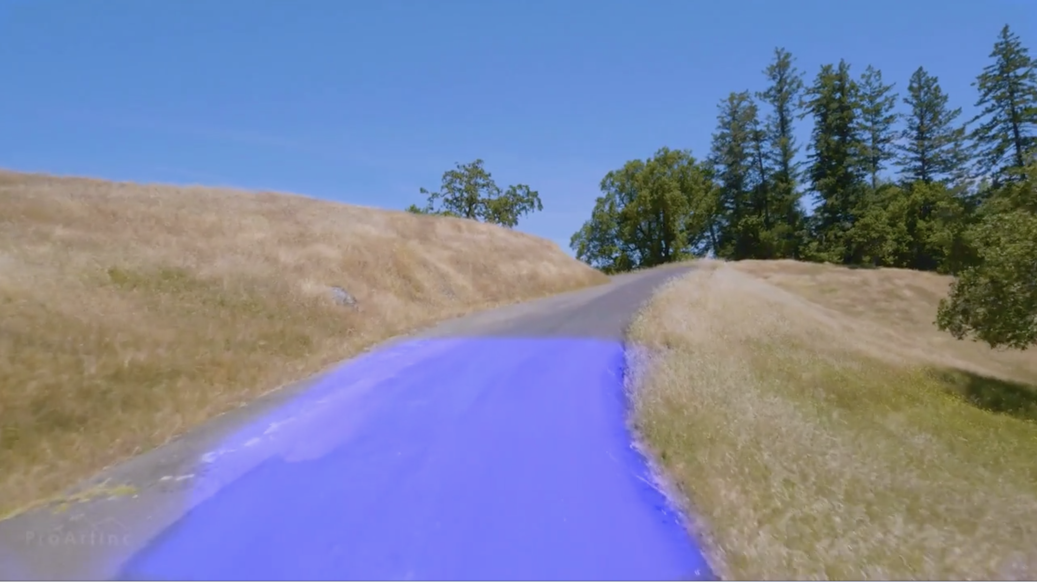
Then, we tried increasing the number of Conv2D and DeConv2D layers.
The resulting output is more stable and successful in both conditions shown.

Slide 12

LSTM
A type of RNN which works with long-term dependencies of sequential data.
Replaced the last two Conv2D layers of our model with ConvLSTM2D layers
Performed better than the original fully CNN network.
Promising results, optimization of parameters is a work in progress.

Slide 13
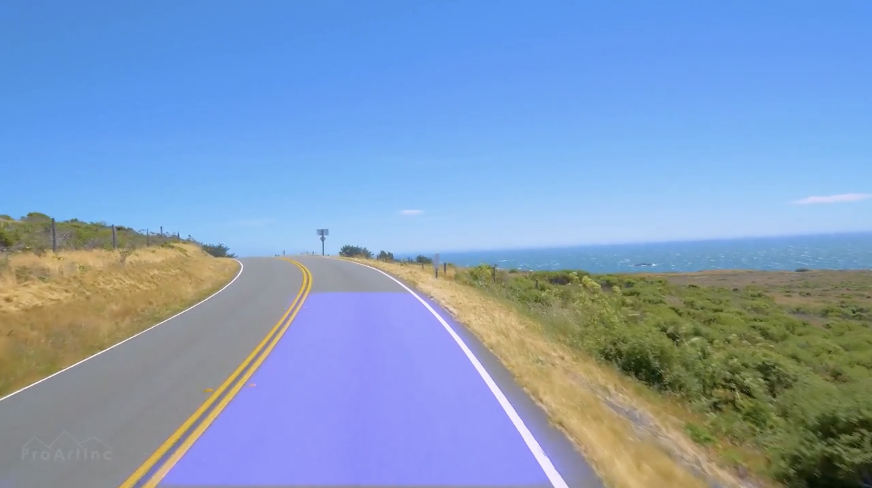
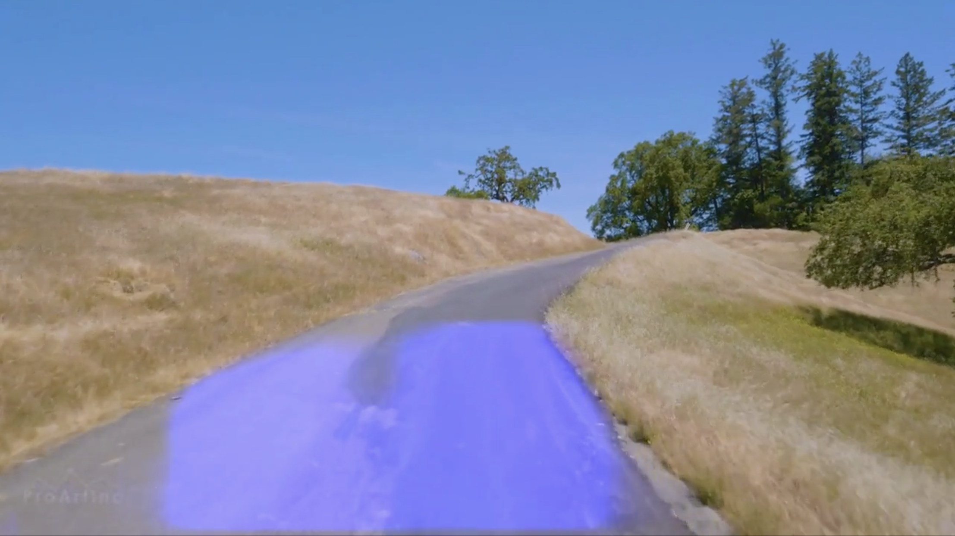
Compared to our refined FCN model, the LSTM model was more unstable in fair road conditions
In the end, we chose our refined FCN

Slide 14
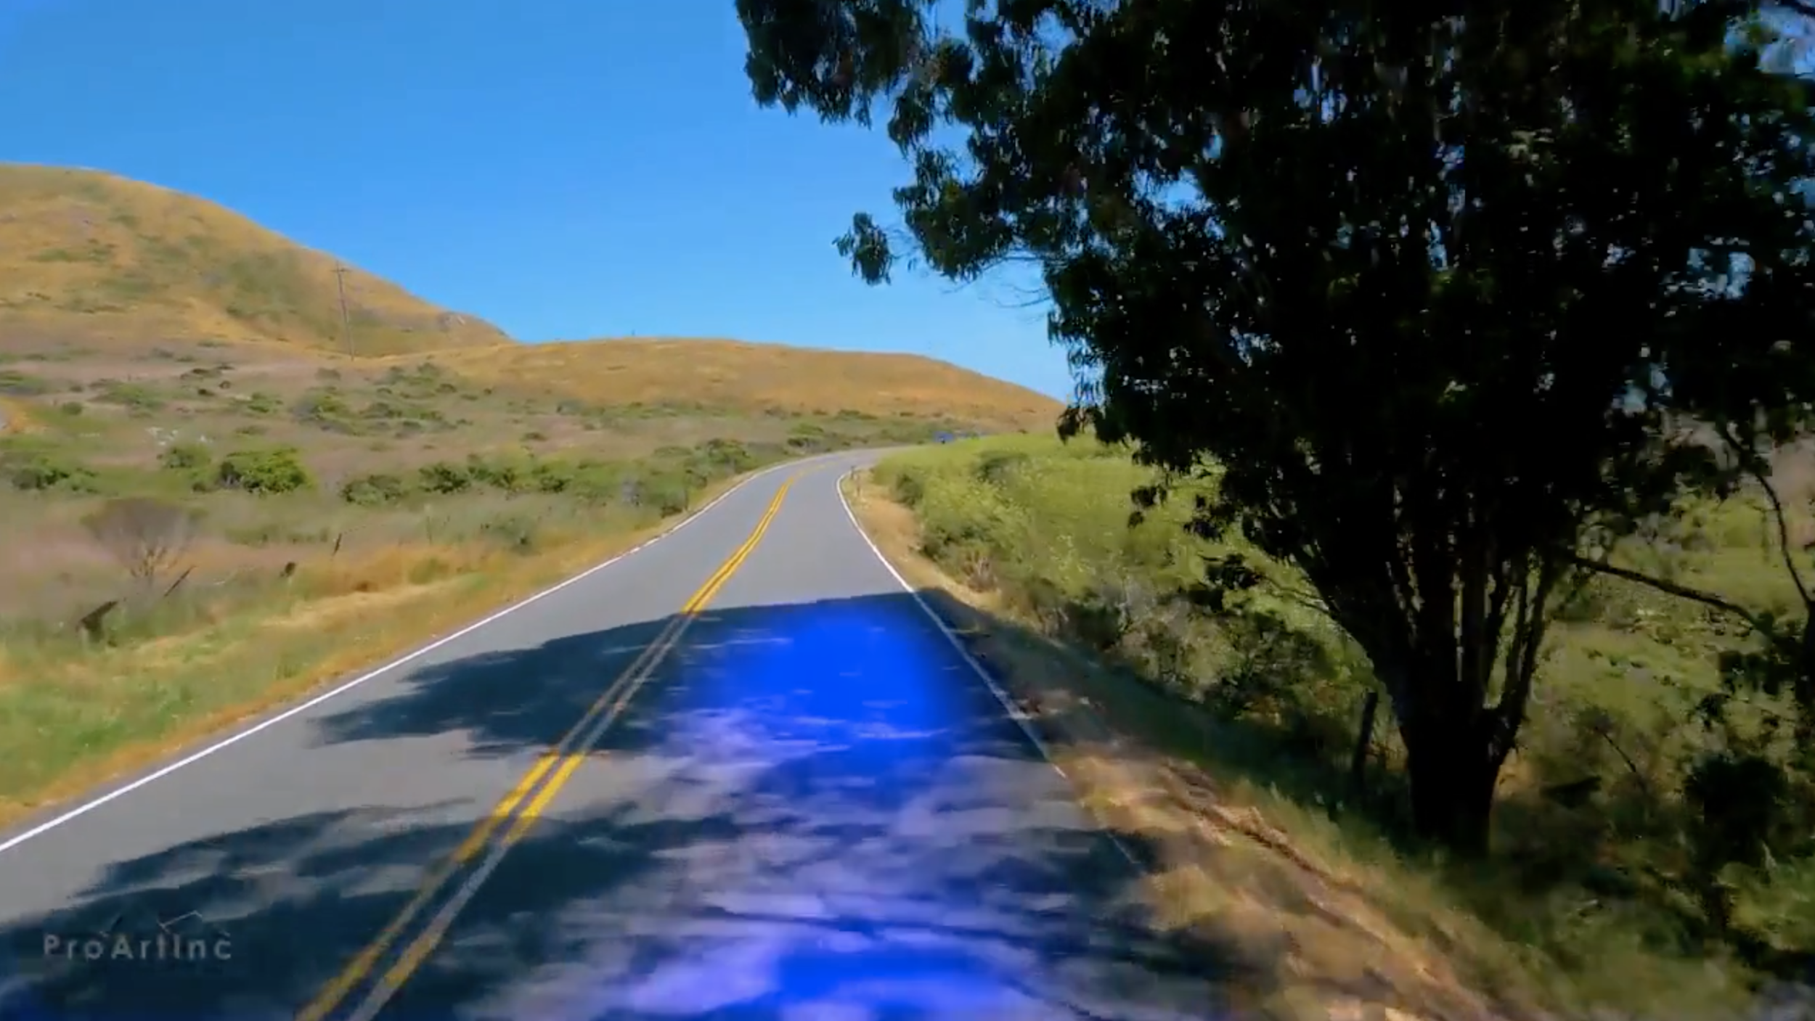
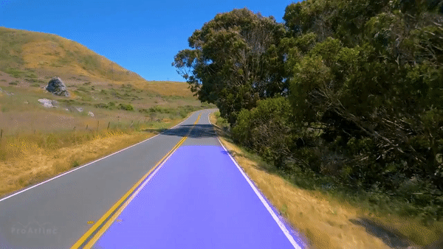
Strengths and Weaknesses
Our model works perfectly on uncovered roads.
When color of the road changes drastically, like in shadows, our model is noisy and we see some fluctuations.

Slide 15
Future Work
The training data we found mainly comes from urban and clear roads, so we need more road which covers shadows, different materials and so on.
Labeling of data takes too much time. Our attempts to automatic labeling:
Transform each frame of video sequence to 1-D luminosity invariant space.
Use Median Filter to filter out some noise.
Use Morphological operators to highlight high contrast edges.

Slide 16
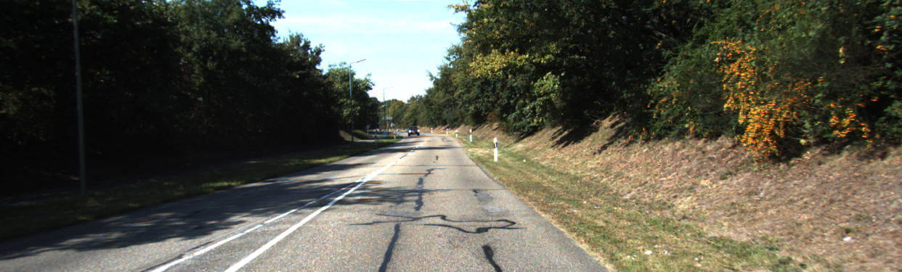
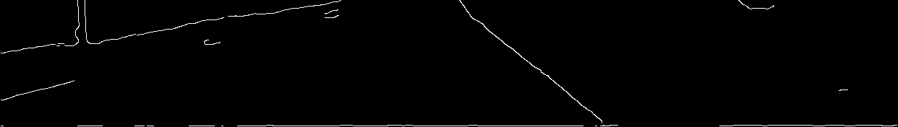
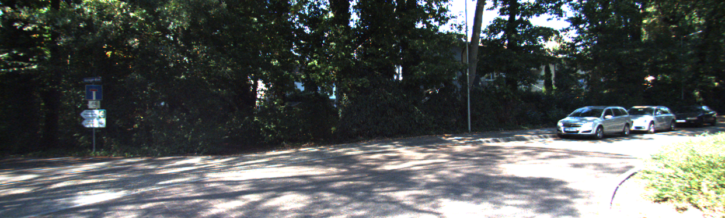
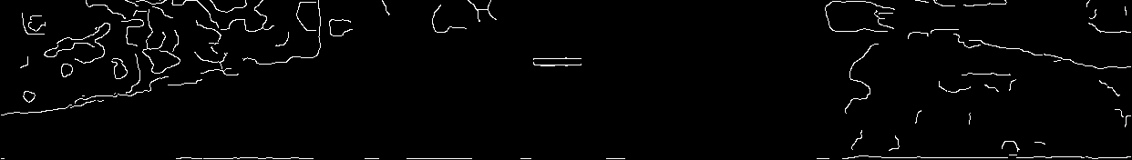
Results of Automatic Labeling:
Fewer shadows
Road Edges
Lots of Shadows and Vehicles
Road Edge

Slide 17
References
Li Xu, Feihu Qi, Renjie Jiang, “Shadow Removal from Images”
G.D. Finlayson, M.S. Drew, “Entropy Minimization for shadow removal”

